Slide 1
Large Language Models for Generative AI
Dr. Monali Mavani

Slide 2

Large Language Models for Generative AI
Disclaimer and Acknowledgement
The content for these slides has been obtained from books and various other source on the Internet
I here by acknowledge all the contributors for their material and inputs.
I have provided source information wherever necessary
I have added and modified the content to suit the requirements of the course
Many slides are adopted from course notes of Zhou, S. (2026). Transformers in Practice. DeepLearning.AI

Slide 3
Agenda
Efficiency in LLM Architectures: FlashAttention, GQA, MQA, MLA
Model Compression Techniques
  Quantization
  Distillation
  Pruning

Slide 4
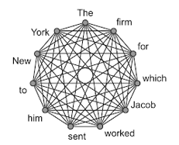
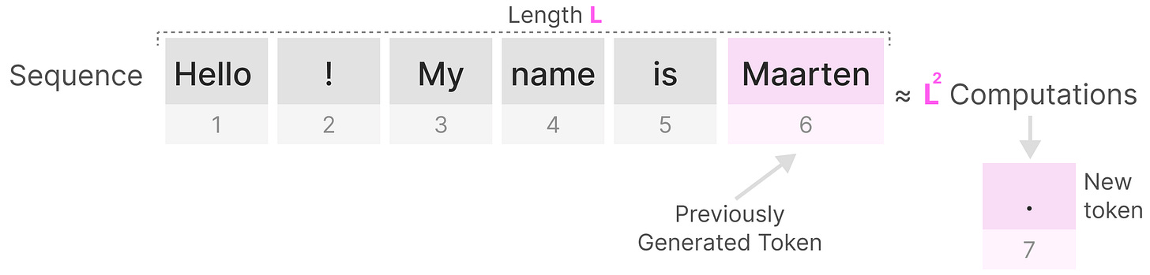
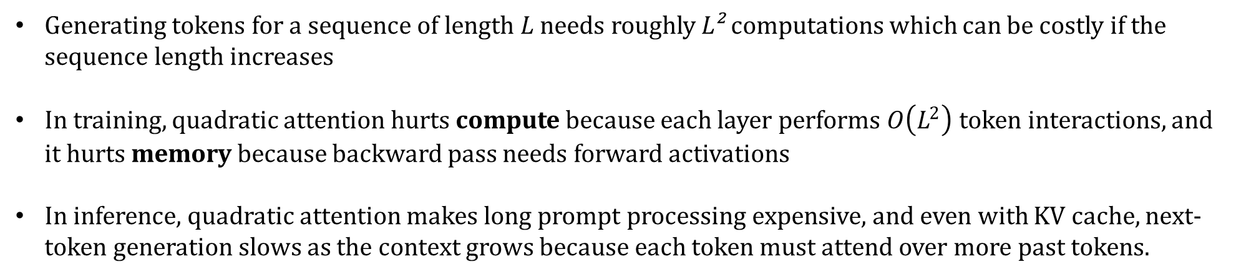
Quadratic attention in transformers
Generating tokens for a sequence of length L needs roughly L² computations which can be costly if the sequence length increases
In training, quadratic attention hurts compute because each layer performs $O\left(L^{2}\right)$ token interactions, and it hurts memory because backward pass needs forward activations
In inference, quadratic attention makes long prompt processing expensive, and even with KV cache, next-token generation slows as the context grows because each token must attend over more past tokens.
https://newsletter.maartengrootendorst.com/p/a-visual-guide-to-mamba-and-state

Slide 5
Standard Softmax Attention
Pros
  Perfect global context — every token attends to every other
  Perfect associative recall — retrieves any specific fact exactly
  Fully parallelizable during training
  Maximum quality ceiling — all other variants are measured against this
Cons
  O(S²) time and memory — quadratic scaling wall
  KV cache grows linearly with conversation length at inference
  Unusable beyond ~4–8K tokens without hardware tricks
  Memory-bound at inference — GPU waits on HBM, not compute

Slide 6
Which method attacks which cost
Filled tags = phases where the method helps
Compute · O(n²)
Memory · KV cache
Training & prefill bound
Decode & serving bound
FlashAttention -Exact
MQA → GQA → MLA
Exact, IO-aware — same math, far faster
Shrink what gets cached (GQA in Llama 3)
Train
Prefill
Decode
Train
Prefill
Decode
Sparse attention- Approximate - attend to fewer tokens
sliding window (simple) · NSA, DSA (learned)
PagedAttention
Manage the cache at serving time
Train
Prefill
Decode
Train
Prefill
Decode
Linear attention · KDA (Kimi Linear)
Attacks both — linear compute, and a fixed-size recurrent state replaces the growing cache
Train
Prefill
Decode
Efficiency gains are well established; “beats full attention” quality claims are still being independently verified.

Slide 7


Memory traffic
Compute units
Compute Units
fast
memory
Memory VRAM
LLM ^{KV}
cache
GPU

Slide 8
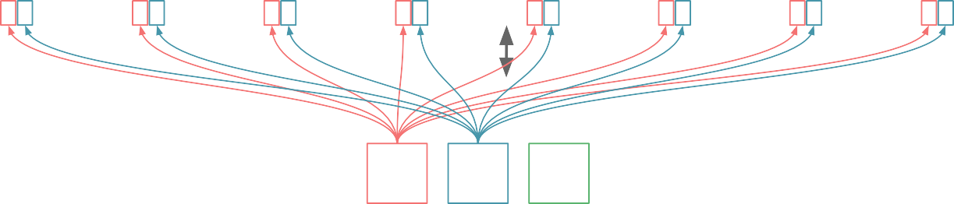
Attention data flow
Compute units
Compute Units
Q K
Q K
Q K
Q K
Q K
Q K
Q K
Q K
Q
K
Memory VRAM
Q K V
KV
cache
LLM
GPU
Load QK in compute unit

Slide 9

Attention data flow
Compute units
Compute Units
Q K S
Q K S
Q K S
Q K S
Q K S
Q K S
Q K S
Q K S
Q
K
Memory VRAM
LLM
KV
cache
Q K V
GPU
Calculate attention score S

Slide 10
Attention data flow
Compute units
Compute Units
Q K S
Q K S
Q K S
Q K S
Q K S
Q K S
Q K S
Q K S
Q
K
Memory VRAM
LLM
KV
cache
Q K V
S
GPU
Write back Score matrix (s) back to VRAM
S is huge : sequence length square (N² ) length

Slide 11
Attention data flow
Compute units
Compute Units
S A
S A
S A
S A
S A
S A
S A
S A
Memory VRAM
LLM
KV
cache
Q K V
S
GPU
Load S back in compute unit to calculate attention weights A : Apply Softmax

Slide 12
Attention data flow
Compute units
Compute Units
S A
S A
S A
S A
S A
S A
S A
S A
Memory VRAM
LLM
KV
cache
Q K V
S
A
GPU
Write back A back to VRAM
A is huge : sequence length square (N² ) length

Slide 13
Attention data flow
Compute units
Compute Units
A
A
A
A
A
A
A
A
Memory VRAM
LLM
KV
cache
Q K V
S
A
GPU
Load A back in compute unit to calculate Final output O

Slide 14
Attention data flow
Compute units
Compute Units
V A O
V A O
V A O
V A O
V A O
V A O
V A O
V A O
Memory VRAM
LLM
KV
cache
Q K V
S
A
V
GPU
Load V in compute unit to calculate Final output O

Slide 15
Attention data flow
Compute units
Compute Units
V A O
V A O
V A O
V A O
V A O
V A O
V A O
V A O
Memory VRAM
LLM
KV
cache
Q K V
S
O
V
A
GPU
Write back O back to VRAM

Slide 16
Memory bottlenecks
Compute units
Compute Units
Memory VRAM
LLM
KV
cache
Q K V
O
V
S
A
_{N}2
GPU
Wasting memory B.W in reloading S and A, both are huge in size

Slide 17
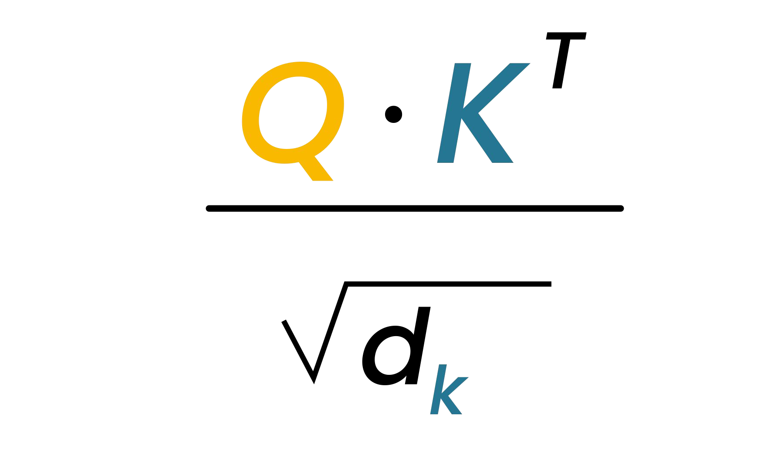
Naive attention flow
Compute units
Q⋅K^{T}
Q K
S
S
softmax
A
A V
O
S
VRAM
A

Slide 18
Naive attention flow
Compute units
Q⋅K^{T}
_{Q K} softmax _{V O}
VRAM
S
S
A
A
S
A

Slide 19
Naive attention flow
Compute units
Q⋅K^{T}
Q K V O
VRAM
S
S
softmax
A
A
S
A

Slide 20
Softmax
_{S =} Q⋅K^{T}
attention scores
attention weights
^{s}11
^{s}21 | ^{s}22
^{s}31 | ^{s}32 | ^{s}33
ª11
ª21 | ª22
ª31 | ª32 | ª33
softmax(S)
ª31 | ª32 | ª33
_{e}score
attention from token 3 to token 1
per query
Entire score row is needed in memory at once before we can compute anything — which forces large reads/writes to slow VRAM (GPU memory)
_{sum(e}scores ₎
Softmax needs complete score rows

Slide 21
Flash attention
Compute units
KV Cache eliminated redundant computation. But even for single-tokens attention computation, there's still a significant amount of data moving back and forth inside the GPU (Giant S and A matrices)
Flash Attention tiles the computation and never materializes the full n×n attention matrix in slow GPU HBM, fusing the operations in fast SRAM.
Q
K
V
O
VRAM
Q K V

Slide 22
Flash attention
Compute units
Q
K
S
A
V O
VRAM
Q K V

Slide 23
Flash attention
Compute units
Q K
V O
VRAM
Q K V

Slide 24
Flash attention
Compute units
Softmax needs complete score rows
_{e}score
per query
_{sum(e}scores ₎
Q K
V O
Running values saved across blocks
Running Value | Purpose
Current max score | Used for numerical stability
Running sum(e^scores) | Accumulates the softmax denominator
Output so far | Partial weighted sum of V, corrected at each step
VRAM
Q K V

Slide 25
Flash attention
Compute units
Mathematically identical to standard attention
Q K
V O
VRAM
O
Q K V
S
A

Slide 26
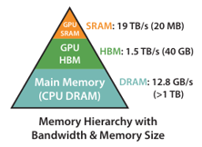
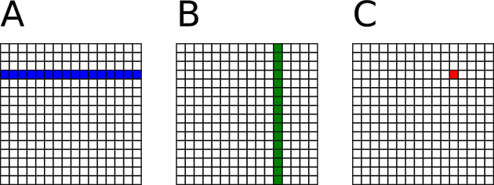
Flash Attention: Making Attention IO-Aware
IO-Awareness recognizes that moving data between slow High-Bandwidth Memory (HBM) and fast on-chip SRAM is the bottleneck. Eg: Matrix multiplication for very large matrices
Problem : Once the sequence length, N, is large, the corresponding Q, K, V matrices cannot fit into the small SRAM. Thus, you must constantly write/read them from the large HBM (quadratic accesses)
Flash attention makes transformer attention faster & more memory-efficient by breaking matrices into smaller chunks, keeping hot data in fast SRAM, and avoiding redundant memory reads/writes to slow GPU HBM
FLOPs are the same as standard attention but memory access is reduced

Slide 27
FlashAttention
Exact attention: same output as standard attention, no approximation
Does not remove quadratic exact-attention compute
Does not by itself solve KV-cache growth during autoregressive decoding
Requires optimized hardware-specific kernels
FlashAttention is typically a backend/kernel choice, enabled by the framework and hardware, rather than a property of the model weights themselves
Flash attention enables longer context windows (e.g. 100K+ tokens) that would be outright impossible with standard attention due to VRAM capacity limits — this is arguably its most impactful practical benefit beyond speed

Slide 28
FlashAttention
You don't need to write FlashAttention. You need to know two things: (1) does your GPU support it (Nvidia Ampere or Hopper), and (2) is the framework you're using already calling it under the hood?
Training / fine-tuning? PyTorch 2.0+ {scaled_dot_product_attention”} or HF Transformers with {attn_implementation="flash_attention_2“}. Both work on A100, H100, L40, RTX 4090. Flash attention 3 does not work on A100
Serving? Pick vLLM or TensorRT-LLM. They bundle it
CPU-only laptop? You don't get FlashAttention. Use llama.cpp or llama-cpp-python — they use different optimizations (GGUF quantization, fused kernels) for the same goal

Slide 29
Sample Question
Scenario: You are building a diagnostic AI for a rare disease. The input is a 2,000-token patient history. Because the disease is rare, the model must calculate the exact relationship between every single symptom mentioned, regardless of how far apart they are. Accuracy is the only metric that matters; hardware costs are irrelevant. Will you choose Standard Softmax or any "efficient" version?
Answer: Use exact attention (the full quadratic view) — either standard softmax or FlashAttention. Both compute the same attention matrix; FlashAttention just tiles the computation to use SRAM efficiently without any approximation. What to avoid are approximate efficient variants — sparse, sliding-window, or linear attention — since these discard entries from the N×N matrix and could miss long-range symptom correlations. At N = 2,000, O(N²) is well within modern hardware budgets, so there's no need to trade accuracy for speed.

Slide 30
Sample Question
Question: You have a single A100 GPU and a 12k-token prompt. Standard Attention is hitting an Out of Memory (OOM) error — not because of the KV cache. You cannot change the model's weights. How do you run this exact model without changing its output math?
Answer: The OOM is caused by the intermediate N×N attention matrix (here ~12k × 12k), which must be materialized in HBM and grows quadratically with sequence length. Use FlashAttention — an IO-aware algorithm that splits Q, K, V into blocks and computes attention in chunks inside the GPU's small but fast SRAM (~20 MB), using running softmax statistics so the full matrix is never stored. This reduces attention memory from O(N²) to O(N) and produces the exact same output as Standard Attention, eliminating the memory bottleneck without altering the model.

Slide 31
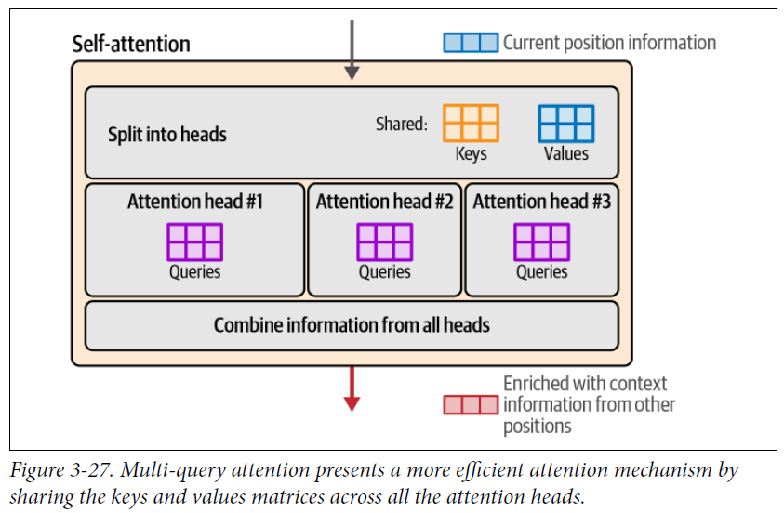
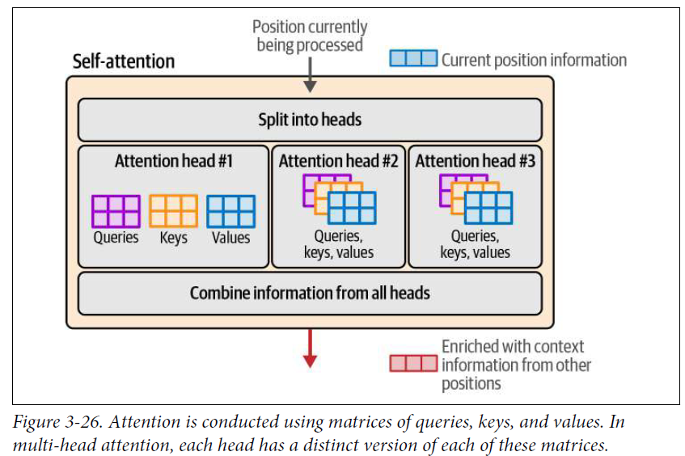
MQA and GQA
Multi-query attention (MQA)
Standard Attention

Slide 32
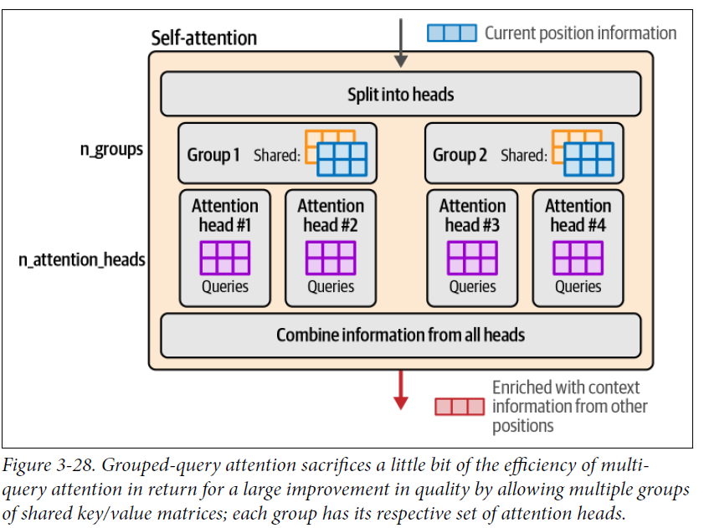
MQA and GQA
Grouped-query attention (GQA)
MQA / GQA — Exact attention computation. They reduce the number of K,V projections (one shared K,V in MQA; G groups of K,V in GQA), but each query head still computes full softmax over the entire sequence.
The "loss" relative to MHA is representational capacity baked in at training time, not an inference-time approximation
A GQA model and an MHA model are simply different models; for a given GQA model, attention is exact
GQA: Model keeps multiple query heads but reduces no. of distinct key and value heads by grouping them
Reduces KV-cache memory
It lowers memory bandwidth pressure during inference

Slide 33
Multi-head Latent Attention(MLA)
Introduced in DeepSeek-V2
Same goal as GQA but different implementation
MLA is a KV-cache compression strategy inside attention. Unlike GQA, which saves memory by sharing K/V heads
MLA saves memory by storing a compressed latent KV state and reconstructing what it needs during inference
~10× smaller KV cache than MHA, quality matches or exceeds it.
More complex
But often more compelling once model size and context length get large enough that cache traffic starts to dominate, because at the same rate of memory reduction, it could maintain better modeling performance
E.g. Sarvam LLM: 30B model keeps classic GQA, while the 105B version switches to MLA
Example architectures : DeepSeek V3, Kimi K2, GLM-5, Ling 2.5, Mistral Large 3, Sarvam 105B
https://magazine.sebastianraschka.com/p/visual-attention-variants

Slide 34
Low-rank approximation
One big matrix ≈ two thin ones through a small bottleneck. MLA applies this to K and V.
Standard attention computes K and V directly from h and caches both (big).
MLA inserts a thin bottleneck of width r between h and K,V — a small latent vector c_KV
The cache stores only c_KV. K and V are rebuilt from it on demand, using the learned up-projection matrices — the U half of the picture on the left.
The general trick
M ≈ U × V
M : (n × m) big matrix
U : (n × r) thin
V : (r × m) thin
Standard: h ──▶ K, V → cache K, V
MLA: h ──▶ c_KV ──▶ K, V → cache c_KV only
r is much smaller than n and m — so the bottleneck of width r stores far fewer numbers than M.
MQA / GQA: shrink cache by sharing K,V across heads → quality drops vs MHA.
MLA: shrinks cache by compressing K,V through c_KV → every head keeps its own K,V → quality matches MHA.
MLA applies it to K and V

Slide 35
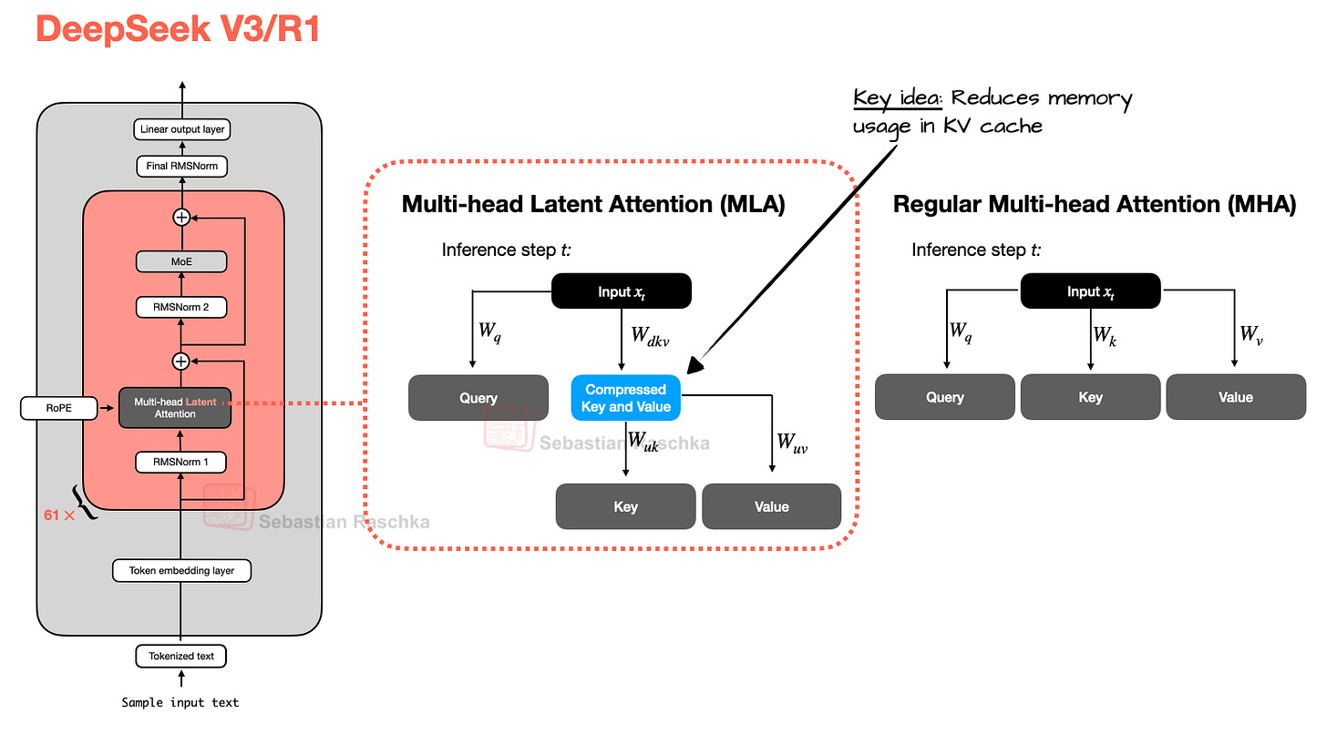
MLA
Instead of caching full-resolution key and value tensors as in MHA and GQA, MLA stores a latent representation
Essentially, it is a cache compression strategy embedded inside attention
https://magazine.sebastianraschka.com/p/visual-attention-variants

Slide 36
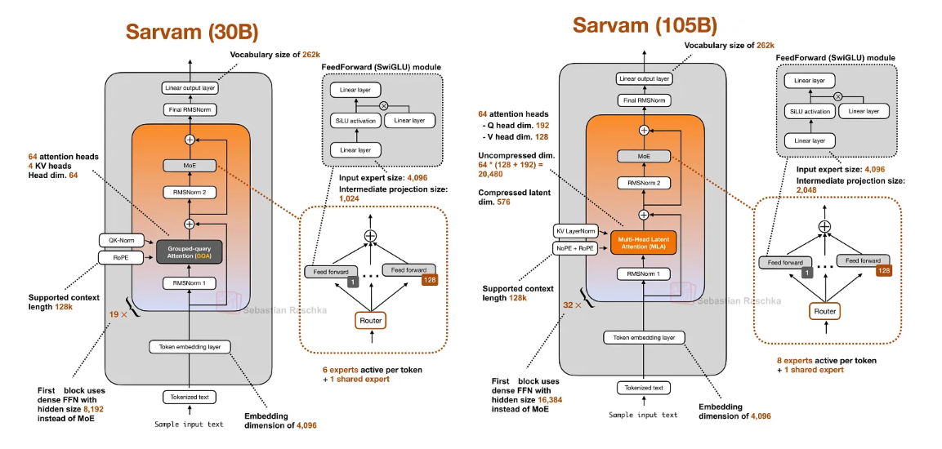

Slide 37
Model Compression
Classical compression (quantization, pruning, distillation) is model-agnostic — it came from the CNN era and applies to any neural network.

Slide 38
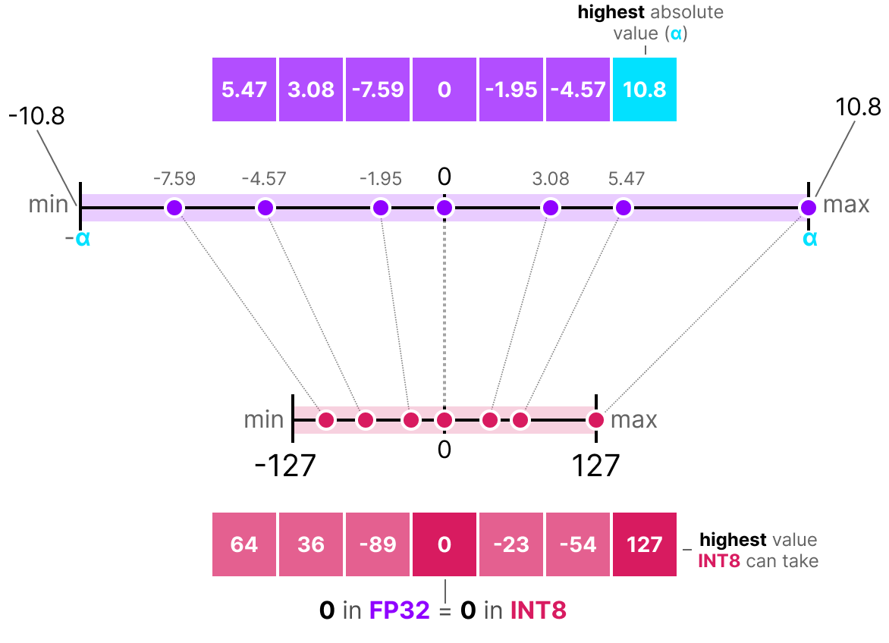
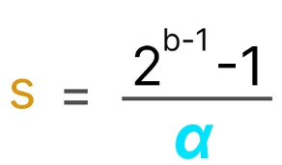

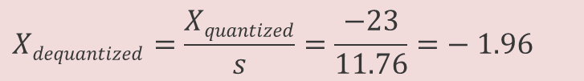
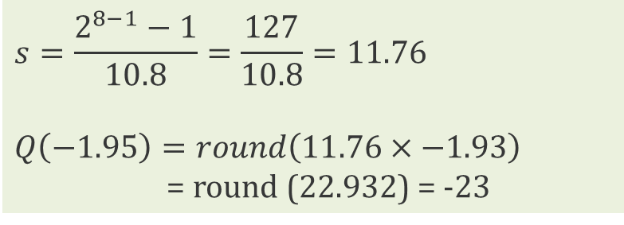
Symmetric Quantization
symmetric quantization: range of the original floating-point values is mapped to a symmetric range around zero in the quantized space
0 in FP32 is 0 in INT 8
E.g. absolute maximum (absmax) quantization
b = no of bytes that we want to quantize to (8)
α = highest absolute value, range to perform the linear mapping
S= Scale factor
Quantization
DeQuantization
$$s=\frac{2^{8−1}−1}{10.8}=\frac{127}{10.8}=11.76$$
$Q\left(−1.95\right)=round\left(11.76×−1.93\right)$
= round (22.932) = -23
$$Xdequantized=\frac{Xquantized}{s}=\frac{−23}{11.76}=− 1.96$$
https://newsletter.maartengrootendorst.com/p/a-visual-guide-to-quantization

Slide 39
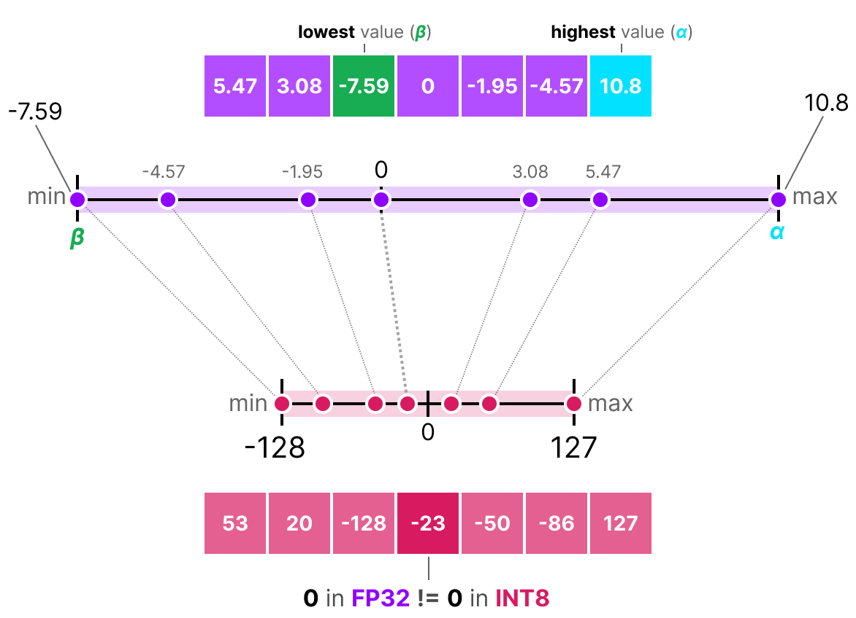
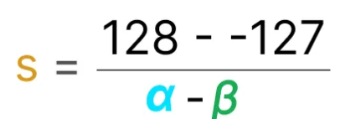

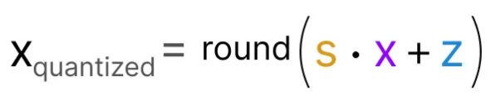
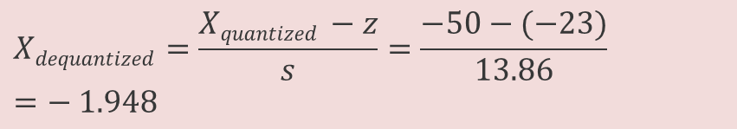
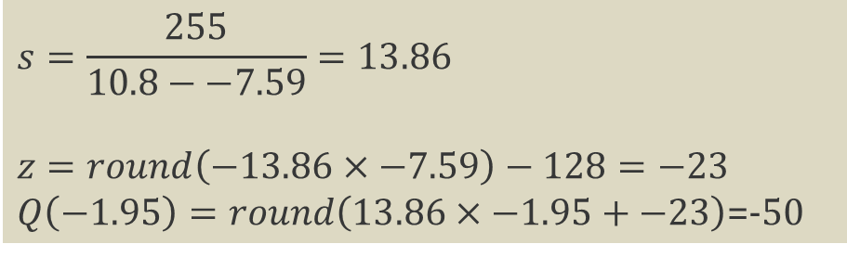
Asymmetric Quantization
Asymmetric quantization: not symmetric around zero
It maps the minimum (β) and maximum (α) values from float range to minimum and maximum values of the quantized range
E.g. zero-point quantization
Quantization
DeQuantization
$$s=\frac{255}{10.8−−7.59}=13.86$$
$$z=round\left(−13.86×−7.59\right)−128=−23$$
$Q\left(−1.95\right)=round\left(13.86×−1.95+−23\right)$=-50
$$Xdequantized=\frac{Xquantized −z}{s}=\frac{−50−(−23)}{13.86}=− 1.948$$
https://newsletter.maartengrootendorst.com/p/a-visual-guide-to-quantization

Slide 40
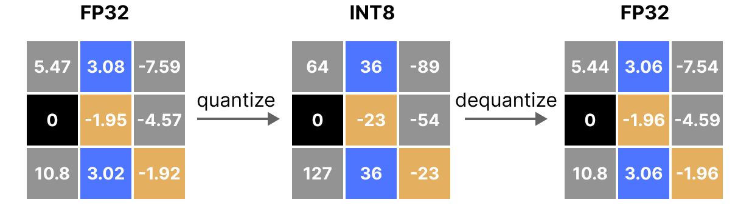
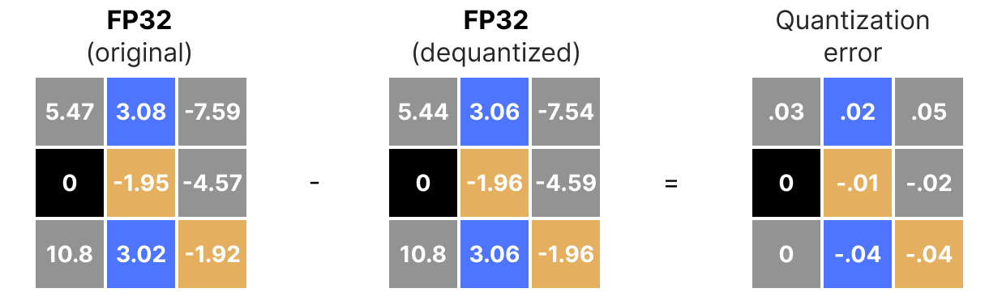
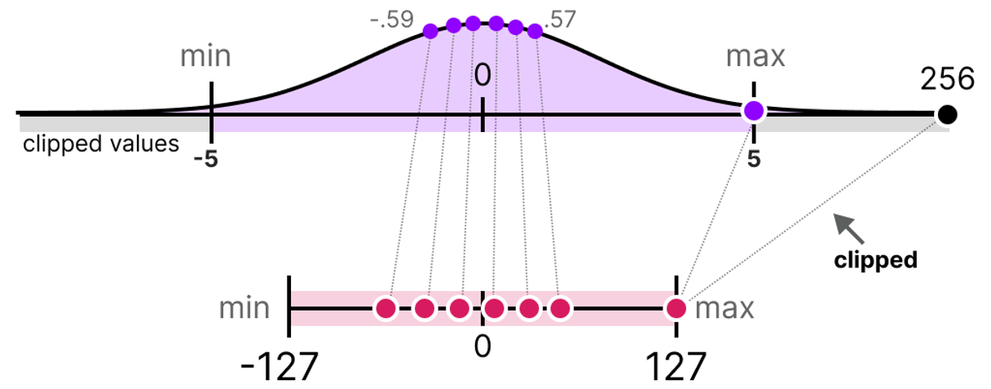
Quantization
calibration
  Process of find a range that includes as many values as possible while minimizing the quantization error
  choosing the range [β, α] you quantize into
Post-Training Quantization (PTQ) : Quantization after training
Quantization Aware Training (QAT): Quantization during training/fine-tuning
https://newsletter.maartengrootendorst.com/p/a-visual-guide-to-quantization

Slide 41
Post-Training Quantization (PTQ)
Compress an already-trained model to lower-bit precision — no retraining. The fast, cheap, default path for deployment.
Calibration data: a small set of text samples (~128–512 sequences) fed through the model so the quantizer can observe how activations actually behave and choose quantization parameters accordingly.
Round-to-Nearest (RTN) is the no-calibration baseline; GPTQ/AWQ/SmoothQuant all use calibration.
What gets quantized:
  Weights only (W4A16): GPTQ, AWQ — standard for deployment, ~4× memory reduction.
  Weights + activations (W8A8): SmoothQuant
Storage formats (different from methods): GGUF (file format, llama.cpp ecosystem), NF4 (dtype used in QLoRA), FP8 (hardware-native on H100/H200).
bitsandbytes is a convenient load-time quantization path; AWQ/GPTQ are more explicit production compression pipelines
GGUF is designed primarily for CPU and Apple Silicon, with GPU offload as an important secondary path
use AWQ/GPTQ for fast GPU-only local inference

Slide 42
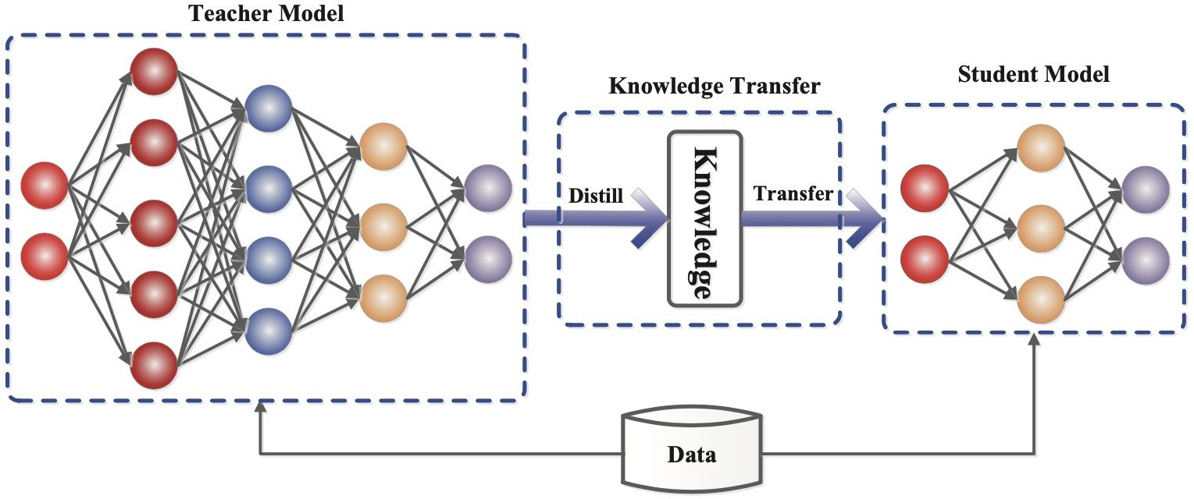
Knowledge Distillation (KD)
The generic firamework ofi teacher-student knowledge distillation training. (Image source: Gou et al. 2020)
Goal: Transfer knowledge from expensive teacher model(s) into a smaller* student model, while retaining capabilities.
*Self-distillation uses the same-sized student and teacher, and can still result in befler performance.
Credits : Rishabh Agarwal, https://www.youtube.com/watch?v=O1AR4iL30mg

Slide 43
Distillation: teach a small model from a big one
Concept. A large teacher model produces outputs (or output distributions) that the student learns to mimic. The student ends up smaller, cheaper, and specialized to the teacher's behavior on a specific task.
Two flavors in practice:
  Response distillation (what most teams actually do): teacher generates a dataset; student is fine-tuned on it with normal cross-entropy loss. No logit access required. Works with any teacher, including closed APIs (modulo terms of service).
  Logit distillation (classical Hinton): teacher's full probability distribution is matched by the student via KL divergence. Requires open access to teacher logits. Used in research and for creating new small base models.
Real examples: Llama-3.2-1B and 3B were distilled from larger Llama models. DeepSeek-R1-Distill-Qwen/Llama variants. Gemma-2-2B from larger Gemma
When to reach for distillation vs alternatives:
  You already have a working large model and want a cheap deployable version → distillation
  You don't have a teacher → fine-tune the small model directly with labeled data
  You want behavior change without retraining → prompt engineering or RAG (cheaper)

Slide 44
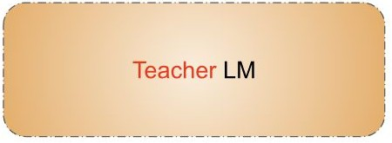



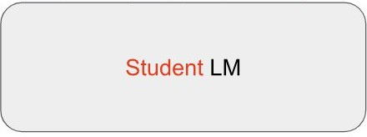

Distillation Using “Synthetic Data”
Synthetic Data Generation
Knowledge distillation is a technique in machine learning where a smaller model (the "student") is trained to mimic the behavior ofi a larger model …
e.g., What is knowledge distillation?
Prompts
Outputs
Supervised Fine-Tuning (SFT)
Prompts
Synthetic Data
Train using next token-prediction
Initially popularized by Sequence-Level Knowledge Distillation (EMNLP, 2016).
Credits : Rishabh Agarwal, https://www.youtube.com/watch?v=O1AR4iL30mg

Slide 45
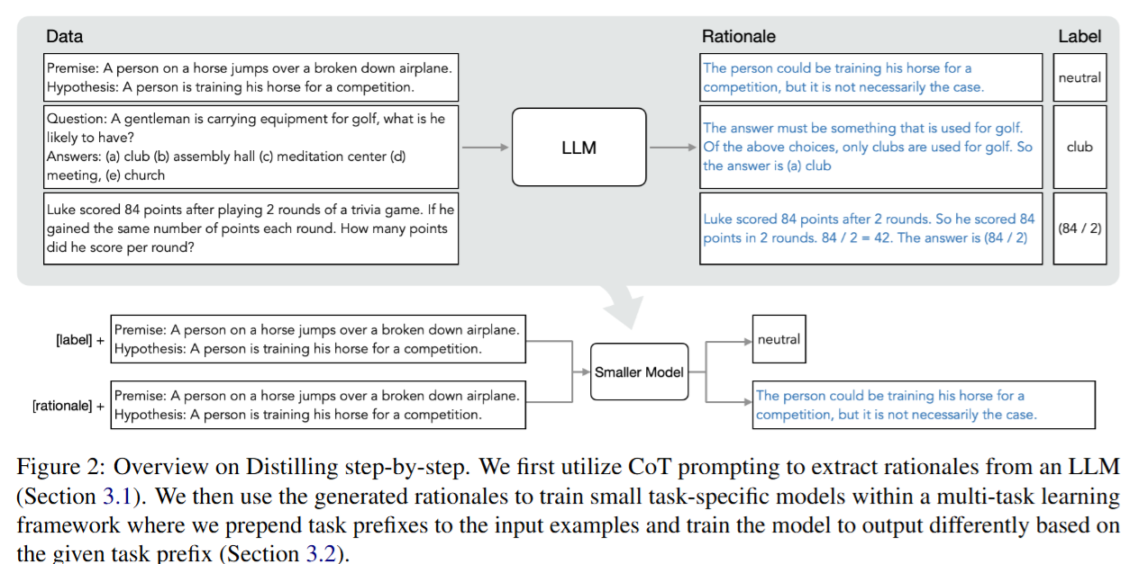
Distilling step-by-step
Distilling Step-by-Step! Outperforming Larger Language Modelswith Less Training Data and Smaller Model Sizes

Slide 46
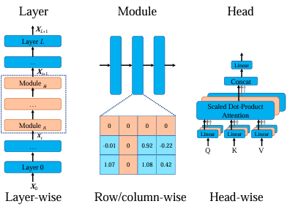
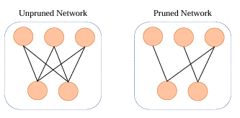
Pruning
Technique to reduce the size or complexity of a model by removing redundant components
Structured Pruning
Removes entire components like neurons, attention heads, or layers based on specific rules, may degrade model performance
Unstructured Pruning
prunes individual parameters, resulting in an irregular sparse structure
A Survey on Model Compression for Large Language Models
Image credits: A Survey on Deep Neural Network Pruning: Taxonomy, Comparison, Analysis, and Recommendations

Slide 47
References
https://magazine.sebastianraschka.com/p/visual-attention-variants
https://magazine.sebastianraschka.com/p/recent-developments-in-llm-architectures
Hands-On Large Language Models by Jay Alammar and Maarten Grootendorst, Oreilly : Ch- 3
https://magazine.sebastianraschka.com/p/beyond-standard-llms
https://docs.nvidia.com/nim/benchmarking/llm/latest/metrics.html
https://huggingface.co/docs/transformers/en/quantization/overview
https://huggingface.co/blog/merve/quantization
https://newsletter.maartengrootendorst.com/p/a-visual-guide-to-quantization
Research Papers
DeepSeek-V2: A Strong, Economical, and EfficientMixture-of-Experts Language Model
MIXED PRECISION TRAINING
FlashAttention: Fast and Memory-Efficient Exact Attention with IO-Awareness
Distilling Step-by-Step! Outperforming Larger Language Modelswith Less Training Data and Smaller Model Sizes

Slide 48
Extra slides not for exam
MLA math

Slide 49
One number MLA shrinks
KV-cache size per token per layer — the decode bottleneck.
Multi-Head Attention (MHA)
MLA target
Store K and V, every head, every token, every layer.
Cache one small latent vector per token.
cache = 2 · n_{h} · d_{h}
cache = 576
= 2 · 128 · 128 = 32,768
MLA
≈ 55 × smaller
numbers per token per layer
Same model quality — in fact, DeepSeek reports better.
128 heads · each head has its own K and V (each 128 wide)
All numbers are DeepSeek-V2 configuration: 128 heads, 128-wide each.

Slide 50
MLA
Solid path = the definition (training). Dashed path = the inference shortcut that skips the grey box.
INFERENCE SHORTCUT: modified query (Wᵁᴷᵀq) attends directly against the cached latent c — K, V never built
hₜ
Wᴰᴷᵛ
cₜ
Wᵁᴷ, Wᵁᵛ
kₜ , vₜ
attention
hidden state
cached latent (512)
full K,V — training only
scores → output
↓ ONLY this is cached
✕ skipped at inference
  DEFINITION — what K, V are (used in training)
  c_{t}^{KV} = W^{DKV} h_{t} (compress)
  k_{t}^{C} = W^{UK} c_{t}^{KV} (up-project the key)
  v_{t}^{C} = W^{UV} c_{t}^{KV} (up-project the value)
  The two W matrices are real, learned weights. This is how the model computes K, V during training.

Slide 51
Factorization — compress, then reconstruct
Replace the dense h → K, V map with a bottleneck at width dₒ = 512.
1
Compress
2
Reconstruct
c = W^{DKV} · h
k = W^{UK} · c v = W^{UV} · c
Squeeze the wide hidden vector h into a small latent c.
Expand c back into full per-head keys K and values V.
Dimensions
k, v ∈ ℝ¹⁶³⁸⁴ full K, V (128 heads × 128)
W^{UK}, W^{UV} ∈ ℝ^{16384 × 512}
Dimensions
h ∈ ℝ⁵¹²⁰ hidden state
c ∈ ℝ⁵¹² latent
W^{DKV} ∈ ℝ^{512 × 5120} squeeze
Each head gets its OWN K and V — nothing shared between heads (unlike MQA / GQA)
c is the ONLY thing cached — one small vector per token

Slide 52
Trick — the up-projection vanishes
At inference, you never actually rebuild K. Here's why.
Score we want to compute:
score = q⊤ · k
Substitute k = (W-UK) · c :
score = q⊤ · (W^{UK} · c)
Rearrange (move W-UK leftward):
score = (W^{UK⊤} · q)⊤ · c
The matrix product (W^{UK⊤} · q) does not depend on which past token j we're scoring against. Compute it ONCE per query, then attend that modified query against the cached latent c directly.
K is never rebuilt at inference.

Slide 53
Same trick for V
The other up-projection (W^{UV}) folds into the output projection (W^{O})
Step 1 — the output is a weighted blend of values. aⱼ = weight on token j, vⱼ = its value:
o = Σ a_{j} · v_{j}
Step 2 — every value is W·c, so pull the shared W out of the sum (it does not depend on j):
o = W^{UV} · (Σ a_{j} · c_{j})
Step 3 — the output matrix glues onto W, giving ONE precomputed matrix:
u = (W^{O} · W^{UV}) · (Σ a_{j} · c_{j})
Precompute the product (W^{O} · W^{UV}) once. The attention computes a weighted sum of the cached latents cⱼ — V is never rebuilt either. Attention runs entirely in the 512-wide latent space.

Slide 54
Models Adopting MLA
DeepSeek V3/R1, V3.1 etc. normalized the design after its introduction in V2
Kimi K2 kept the DeepSeek recipe and scaled it up
GLM-5 adopted MLA together with DeepSeek Sparse Attention (from DeepSeek V3.2)
Ling 2.5 paired MLA with a linear-attention hybrid
Sarvam released two models where the 30B model stayed with classic GQA and the 105B model switched to MLA

